Slide 1

Training Neural Networks
A deep dive into how neural networks learn — from architecture and loss functions to backpropagation and optimization.

Slide 2
Contents
01
02
Neural Networks-Recap
Training Neural Networks-Components
03
04
Input, Hidden, Output Layers
Loss Function
05
06
Backpropagation Method
FNN , CNN and RNN

Slide 3
Introduction to Neural Networks: Recap
A Neural Network (NN) is a computational model inspired by the biological brain. It consists of interconnected processing units called neurons arranged in layers.
Neuron Operation
Nonlinear Mapping
Applications
Receives inputs, applies weights and bias, passes result through an activation function.
Stacking neurons and layers enables learning of complex nonlinear relationships.
Image recognition, speech processing, finance, healthcare analytics, and marketing modelling.

Slide 4
Training Neural Networks: Key Components
01
02
03
Input Layer
Hidden Layer
Output Layer
04
05
06
Loss Function
Gradient Descent Method
Backpropagation (Optimization
And Learning Methods)
Activation Function

Slide 5
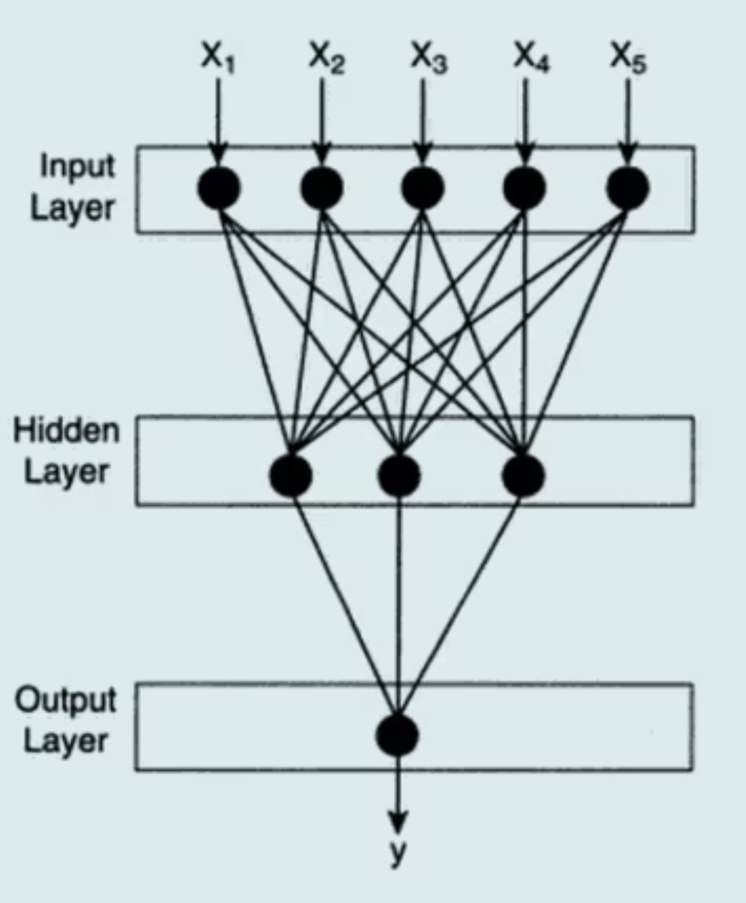
Network Architecture
Input Layer
Hidden Layers
Output Layer
Receives raw input features. Number of neurons equals the number of predictor variables. A 28×28 grayscale image → 784 neurons.
Perform core computation — extract patterns, detect relationships, transform data. Deep networks learn hierarchical representations: edges, shapes, objects.
Produces the final prediction. Structure depends on problem type: regression, binary, or multi-class classification.

Slide 6
Output Layer Structure
Regression
Binary Classification
Multi-class Classification
One neuron — continuous output
One neuron with sigmoid activation
One neuron per class with softmax activation

Slide 7
Choosing Hidden Layers and Neurons
There is no universal rule. Design depends on complexity of relationship, amount of data, noise, and computational constraints.
General Guidelines
The Bias-Variance Trade-off
Start with 1–2 hidden layers
Increase neurons gradually if underfitting occurs
Apply regularization or reduce neurons if overfitting occurs
Too many neurons → increased variance, risk of memorization
Too few neurons → increased bias, reduced learning capacity
Architecture selection is empirical and based on validation performance.

Slide 8
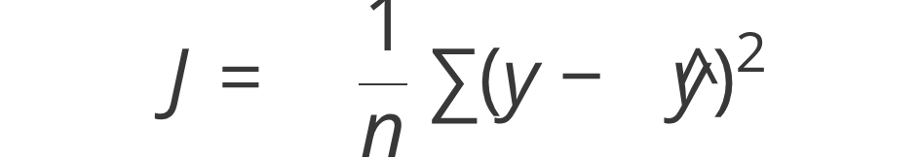
Training Objective and Loss Function
Training involves estimating parameters (weights) such that prediction error is minimized. Error is measured using a loss function J(θ), which quantifies the difference between predicted and actual output.
Mean Squared Error (MSE)
Binary Cross Entropy
Categorical Cross Entropy
Used in regression problems.
Used when predicting probability of binary class membership.
Used in multi-class classification where the model outputs a probability distribution.

Slide 9




Learning Mechanism
Training proceeds iteratively using four steps:
Forward Pass
Loss Computation
Input propagates through the network layer by layer.
Final output is produced and loss is evaluated.
Backpropagation
Parameter Update
Error is sent backward through the network.
Weights are adjusted to reduce future error.

Slide 10
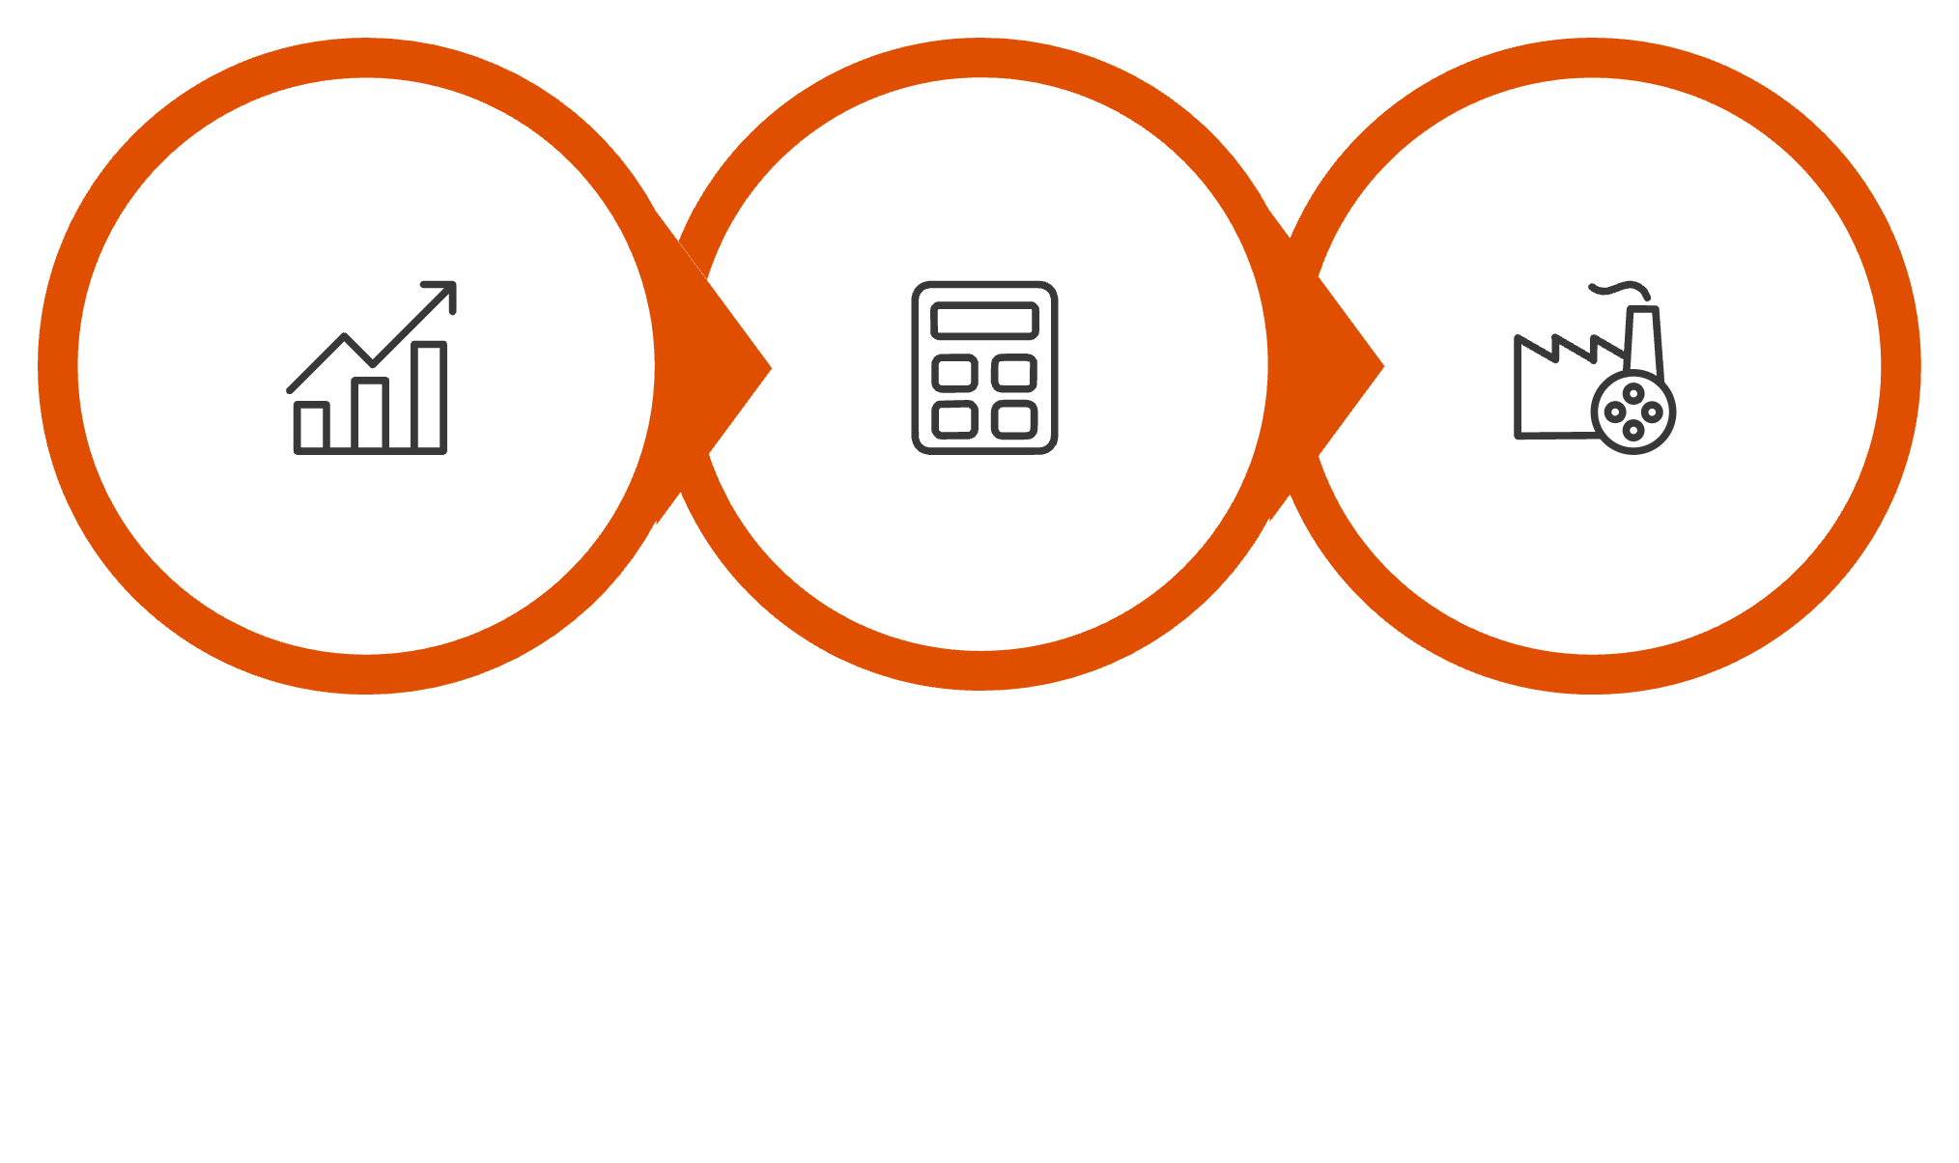
Forward Pass
Input data propagates through the network layer by layer. Each neuron computes a weighted sum followed by activation. The final output is produced and loss is evaluated.
Input
Compute
Output
The forward pass transforms raw inputs into a prediction — the starting point for measuring how wrong the
network is.

Slide 11
Backpropagation
After comparing the prediction with the true value, a loss (error) is obtained. Backpropagation propagates the gradients of the loss backward through the network to quantify how each neuron and weight contributed to the final prediction error.
Key Idea
Chain Rule
In Simple Terms
If a neuron strongly influenced the wrong prediction, its weights change more. If it had little influence, its weights change less.
Using calculus, the algorithm computes how sensitive the loss is to each weight — these gradients are used by gradient descent to update parameters.
"How much did each weight contribute to the final prediction error?"
Note: Weight updates depend on the gradient of the loss with respect to each weight — larger gradients lead to larger parameter
updates.

Slide 12
Backpropagation: Intuitive Analogy
Think of a neural network as a multi-stage factory producing a final output. Raw material (input data) passes through several stages (layers). Finally, a finished product (prediction) is produced.
If the final product is defective (prediction error), we must determine which stage contributed how much to the defect. Backpropagation sends the error signal backward, assigning responsibility based on each stage's influence.
Forward Pass
Backward Pass
Makes the prediction.
Explains the mistake.

Slide 13
Gradient Descent Optimization
Gradient Descent finds parameter values (weights and biases) that minimize the loss function. The gradient indicates the direction in which loss increases most rapidly — so parameters are updated in the opposite direction.
w
J
∂J/∂w
η
Model parameter
Loss function
Gradient (sensitivity of loss to parameter)
Learning rate (step size)

Slide 14
Gradient Descent Intuition
Goal: Minimize Loss Function
• Move in direction opposite to gradient
• Learning rate controls step size
• Iteratively reach optimal weights
Think: Rolling down a hill to lowest point

Slide 15
Role of Bias
Bias plays a role similar to the intercept in regression:
Without Bias
With Bias
Activation boundaries are constrained to pass through the origin.
Improves flexibility and representational power of the model.

Slide 16
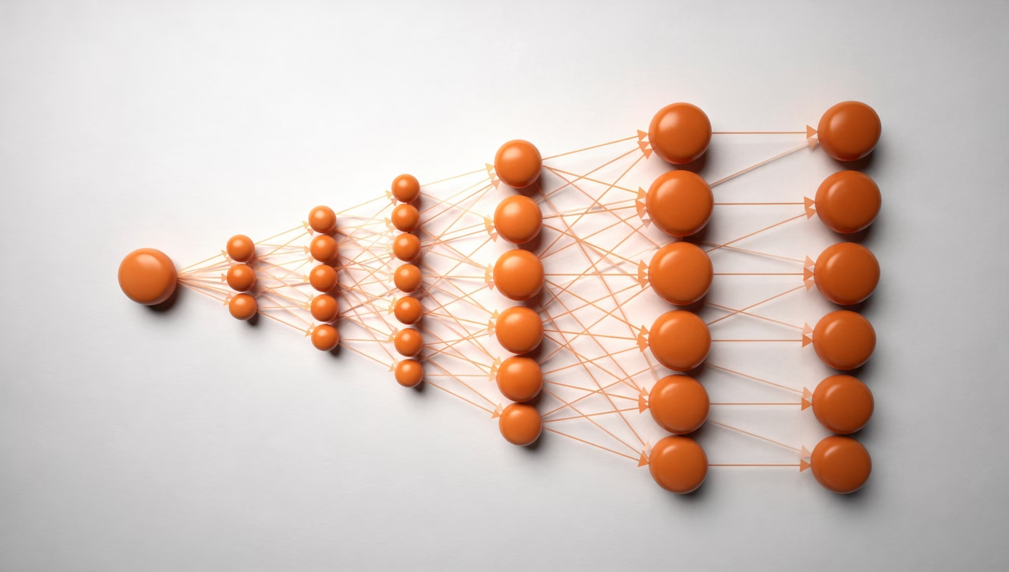
Feedforward Neural Network (FNN)
How It Works
Information flows only in the forward direction — from input to output with no cycles.
Use Cases
Tabular data such as credit scoring and marketing analytics.
Limitation
Does not efficiently exploit spatial or temporal structure present in raw data.

Slide 17
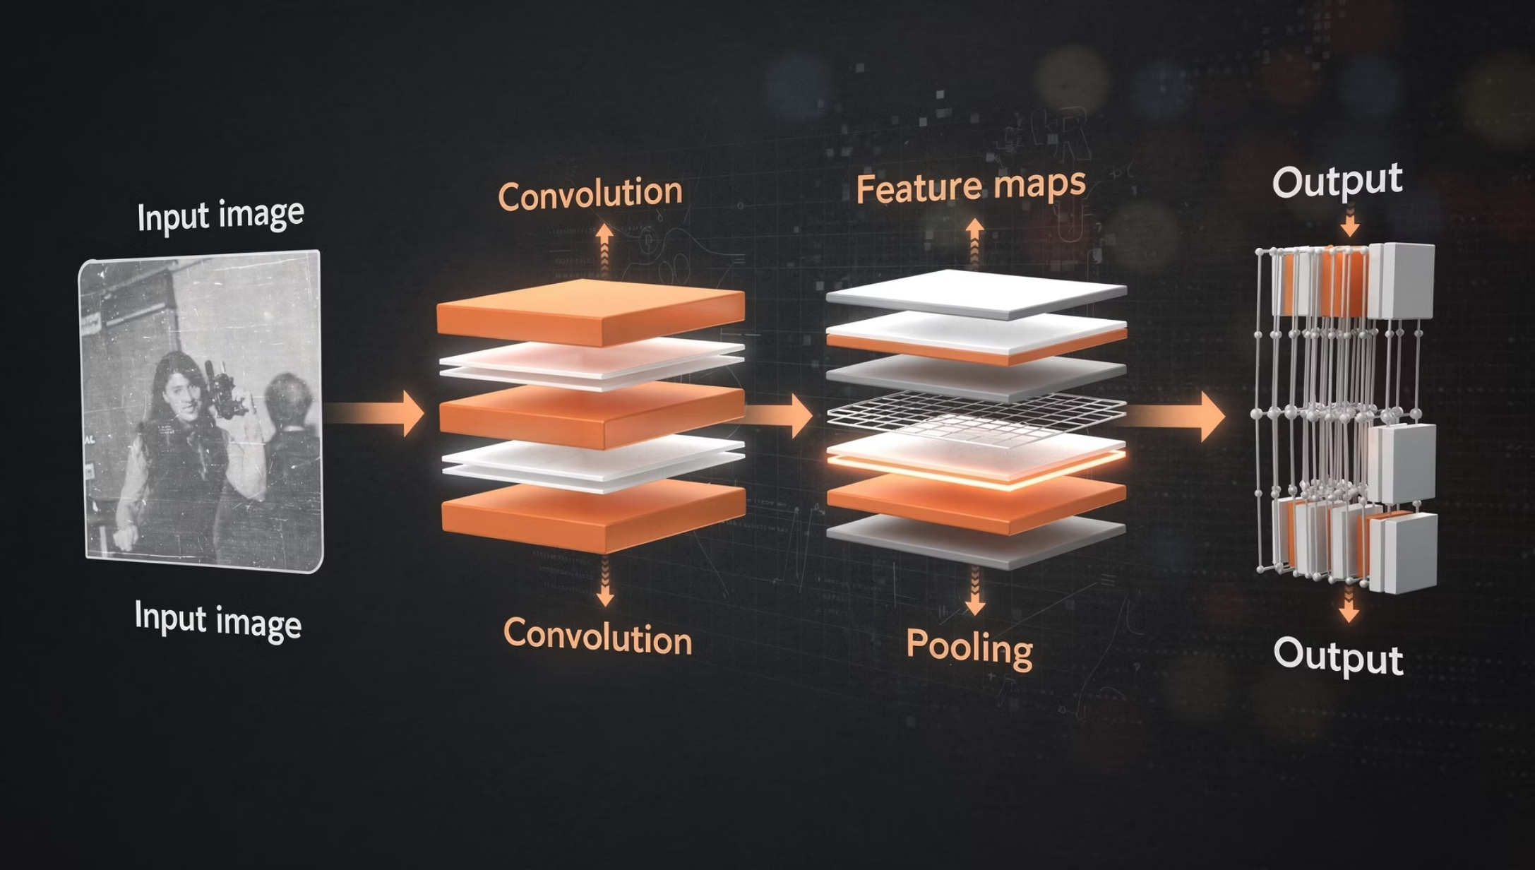
Convolutional Neural Network (CNN)
How It Works
Uses small moving filters to scan the input and detect meaningful local patterns like edges, textures, or shapes
Key Advantages
Parameter sharing
Translation invariance
Use Cases
Computer vision and medical imaging.

Slide 18

Recurrent Neural Network (RNN)
How It Works
Maintains a hidden state that captures information from past inputs in the sequence.
Use Cases
Sequence modelling such as language processing and time-series forecasting.

Slide 19
Key Takeaways
Hierarchical Representations
Neural networks learn hierarchical nonlinear representations from data.
Optimization Problem
Training is fundamentally an optimization problem — minimize the loss function.
Backpropagation
Enables efficient gradient computation across all layers via the chain rule.
Activation Functions
Enable expressive, nonlinear modelling across deep architectures.
Architecture Design
Empirical and data-dependent — validated through experimentation.

